Slide 1

Go Serverless - Breeze through your Cloud Journey
Chandra Mohan Dhanasekaran
AWS Cloud Architect

Slide 2
What is Serverless?
AWS Serverless Services - A Quick Intro
Agenda
Serverless in Numbers
What is Terraform? - The IaC Wonder
Topics to Discuss
Workshop Demo Session + Hands-On

Slide 3


Slide 4


Slide 5
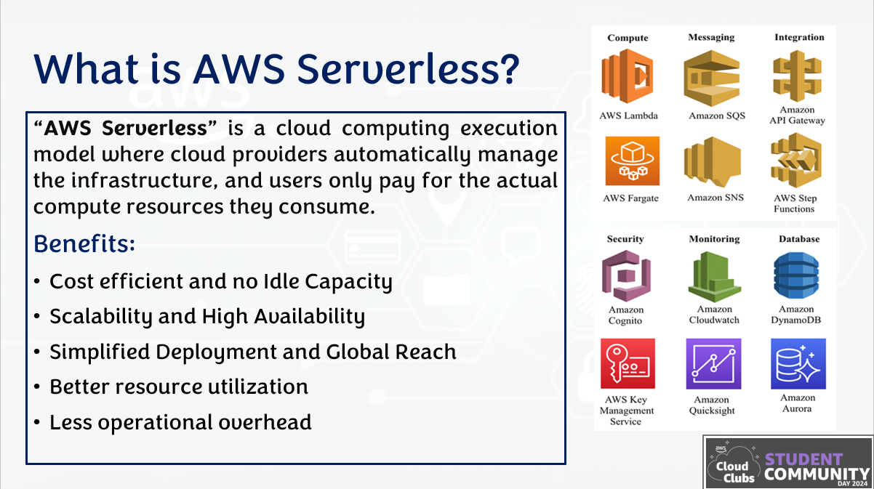

Slide 6
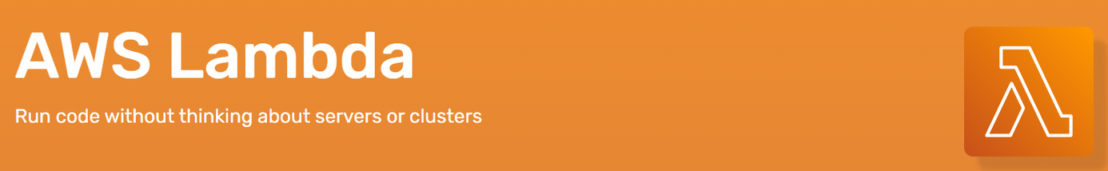
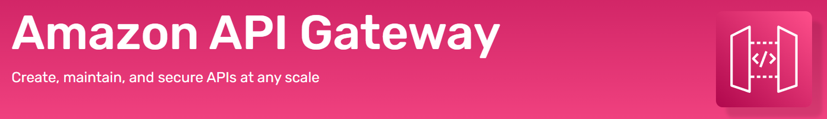
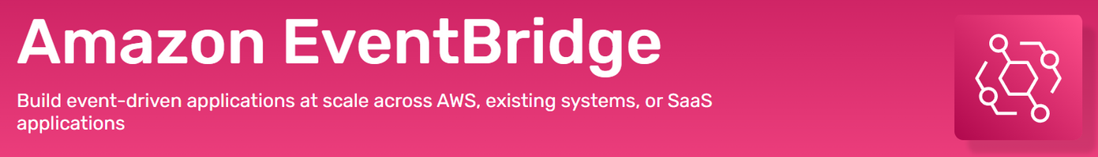
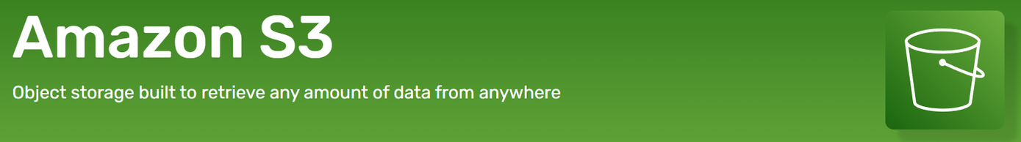
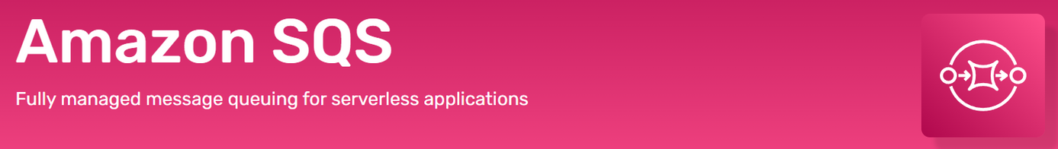
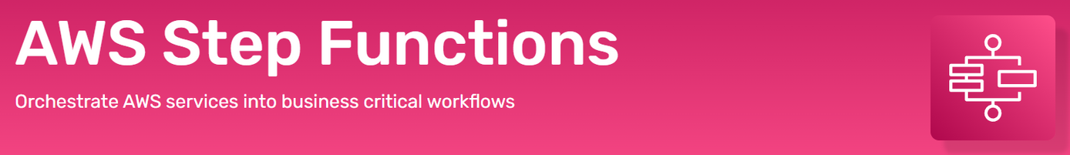
AWS Serverless Services - A Quick Intro

Slide 7
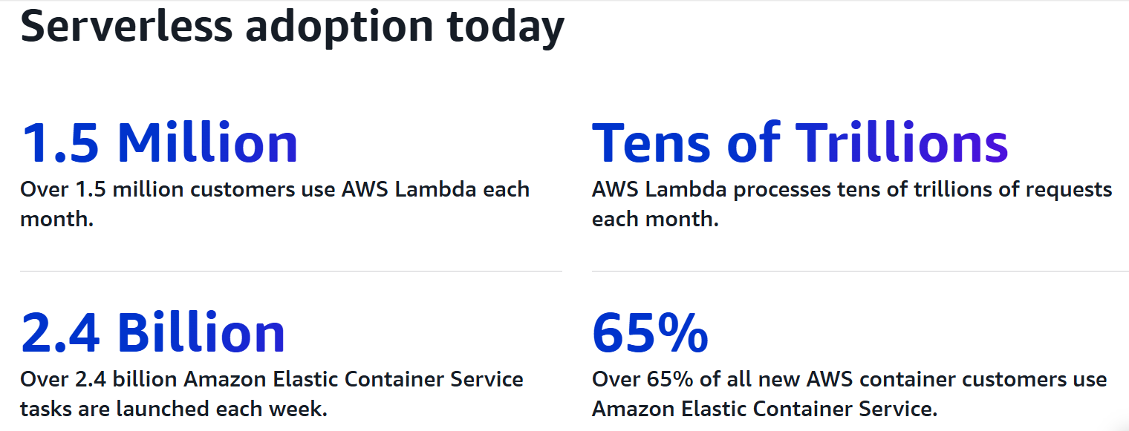
Serverless in Numbers

Slide 8
What is Terraform?
Terraform is an open-source Infrastructure as Code (IaC) tool created by HashiCorp that allows you to define, provision, and manage cloud infrastructure using a declarative configuration language called HCL (HashiCorp Configuration Language).
Key Features of Terraform:
Declarative Language: You define the desired state of infrastructure, and Terraform makes necessary changes to match it.
Multi-Cloud Support: Works with AWS, Azure, Google Cloud, Kubernetes, and even on-premises environments.
State Management: Maintains a state file (terraform.tfstate) to track infrastructure changes.
Dependency Management: Automatically figures out resource dependencies and provisions them in the correct order.

Slide 9
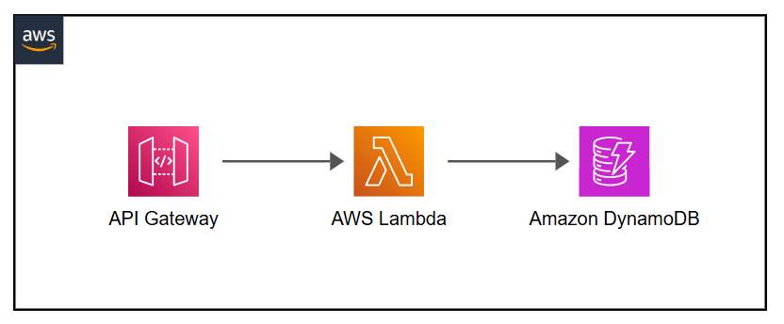
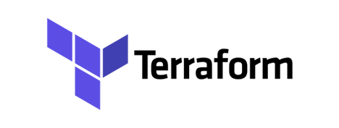
Demo Setup

Slide 10
Workshop Demo + Hands-On

Slide 11
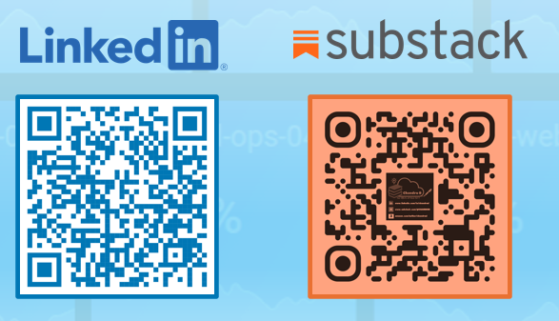
Please feel free to connect!

Slide 12


Slide 13

Session Presentation
+
Code

